Slide 1
Mojo 🔥
Python's faster cousin or just hype?​
Notes:
Good Morning Berlin, Let's jump right in.
If you go to this website, the Mojo playground, and type this code "print("Hello, Mojo")", the console outputs "Hello, Mojo".
Similarly, If you go to this playground, and click button, and download this file, then run this CLI command you get a "Hello Mojo" message.
It's easy to get started and jump into Mojo, but should you? That's what this talk aims to find out.

Slide 2
Agenda
(Who or) What is Mojo?
Mojo Performance
Mojo Usability
Mojo Governance and Community
Call to Action

Slide 3

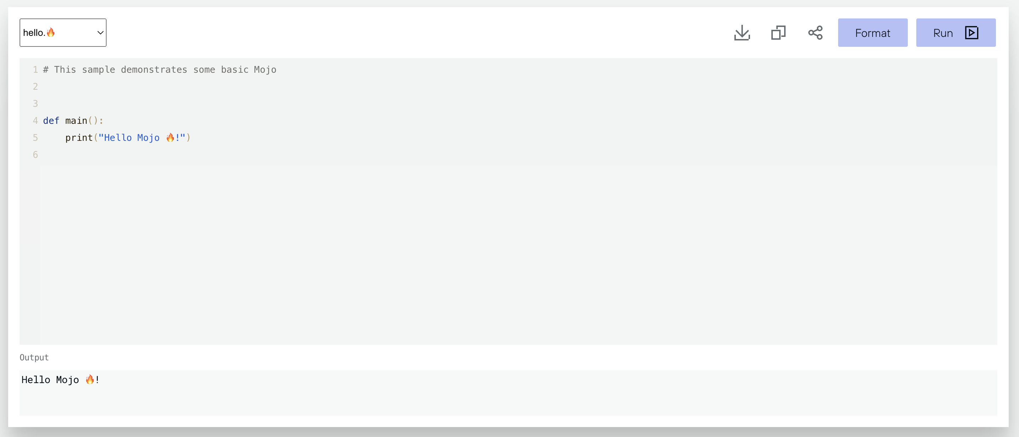
Demo Playground https://docs.modular.com/mojo/playground

Slide 4

Who or what is Mojo?

Slide 5
What is Mojo 🔥?
Version 0.1 was released in May 2023. Currently 8 minor versions later as of the v24.2 release.
Python variant for systems-level and AI programming
Fixes fragmentation between Cuda, C++ and Python.
Built using 'Next Generation' Compiler Technology, MLIR.
"The Programming Language for all AI Developers"
Notes:
Let's start from the beginning, Mojo is a systems-level language designed to have very similar syntax to Python.
Developed by the highly experienced team of compiler engineers at Modular.
AI development suffers heavily from fragmentation at every layer of the stack, requiring domain expertise in C++, Python, and hardware specific code such as assembly or CUDA. Modular’s vision was to simplify the portability of code by developing a common programming model across AI hardware, to fully unlock low-level systems programming and high-level AI application development.
Mojo is the first programming language targeted at AI developers released it to the world in May 2023. We built on top of next-generation compiler technology [MLIR](https://mlir.llvm.org/) and built a completely new end-to-end AI compiler. Mojo generalizes code to vastly different hardware, including CPUs, GPUs, and TPUs.
Modular wants to make Mojo the programming language for all AI developers. We'll look at the performance the usability, and the open-source cred of Mojo to see whether Mojo is ready to set the Python world ablaze, kindling early sparks or just a damp squib?
For non-native English speakers, a damp squib is a something that starts with great promise but doesn't deliver on expectations, such as the fizzle of a firework without any explosion or sparks.

Slide 6
What is Max 🏎️?
Modular Accelerated Xecution (rad) has a developer version and a commercial version offering faster testing/deployment.
AI Compiler and runtime to optimise AI models for inference
Input from TensorFlow, Pytorch and ONNX models.
Optimised models from Max Engine deployed as microservices with Max Serving
"Max: Completing Mojo's AI Story"
Notes:
MAX: Completing Mojo’s AI story
Modular Accelerated Xecution (sigh).
A commercially-licensed Enterprise Edition. The Enterprise Edition will allow you to seamlessly test and deploy the same MAX components you've downloaded in the Developer Edition into a production environment. This will include support for production services such as EC2, EKS, and SageMaker on AWS.
Modular MAX Engine is a high-performance AI compiler and runtime designed to optimize and accelerate AI models for inference. It is built on top of the MLIR compiler infrastructure and leverages graph-level optimizations to improve the performance and efficiency of AI models.
Mojo is a programming language designed for systems programming and AI development, while MAX Engine is a compiler and runtime system for optimising and deploying AI models.
MAX Engine can take models from popular AI frameworks such as TensorFlow, PyTorch, and ONNX as input. It optimizes these models and generates highly efficient code for inference.
Integration with MAX Serving: MAX Engine can be used in conjunction with MAX Serving, a model serving system that enables low-latency and high-throughput inference. Optimized models from MAX Engine can be easily deployed as microservices using MAX Serving.

Slide 7

Chris Lattner Co-founder and CEO.
Co-founder and CEO of Modular AI.
Built and scaled many open source compiler infrastructures, including LLVM, Clang, MLIR, and CIRCT.
Built, managed, and launched the Swift programming language.
Scaled ML systems globally bringing Google Cloud TPUs to market, unifying the ML compiler stack at Google (and beyond) with MLIR, scaling Google's SW and HW on both server and edge to impact billions of users. Head of Autopilot at Tesla.
Contributed to many other commercial and open source projects at Apple, Tesla and Google.
Taken from Personal Website - https://nondot.org/sabre/
Notes:
The language is being developed by Chris Lattner and the Modular team. Chris Lattner has experience across big tech, leading teams at Apple, Google and Tesla. In the open, he's been a core contributor for Clang, OpenCL, LLVM, and Swift.
Chris Lattner is a legendary software and hardware engineer, leading projects at Apple, Tesla, Google, SiFive, and Modular AI, including the development of Swift, LLVM, Clang, MLIR, CIRCT, TPUs, and Mojo.
Chris Lattner built Swift, which was Apple's successor to Objective-C. It added a bunch of features and changed some of the syntax.
Below are three example code snippets in both objective-C and Swift to illustrate how the old syntax compares to the successor language's syntax.
Swift is to Objective-C, as Mojo is to Python
If the modular team do want to create a related but not identical syntax, the differences might look like the jump to Swift from Objective-C.

Slide 8

Who are Modular?
Crunchbase lists them as a company of 11-50. Last year, took $100M of VC Money. The Open Careers page gives an indication for Modular's forthcoming priorities.
AI Compiler Engineer
AI CPU Performance Engineer
AI GPU Performance Engineer
AI Runtime Tech Lead
Cloud Services Engineer
Platform Engineer, Performance Infrastructure.
Software Engineer, Client Team, AI Frameworks.

Slide 9

Performance

Slide 10
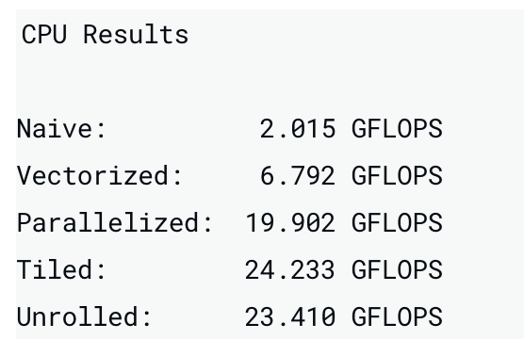
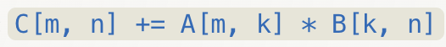
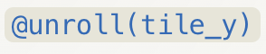
68,000x faster than Python
Matmul.mojo from https://docs.modular.com/mojo/playground
Notes:
Naïve: Perform matrix multiplication using nested loops without any optimizations.
Vectorised: Utilize SIMD (Single Instruction, Multiple Data) instructions to perform multiple operations simultaneously.
Parallelised: Distribute the computation across multiple threads or processors to achieve parallel execution.
Tiled: Divide the matrix into smaller tiles to improve cache locality and reduce memory accesses.
Unrolled: Replicate the loop body multiple times to reduce loop overhead and enable better instruction-level parallelism.

Slide 11
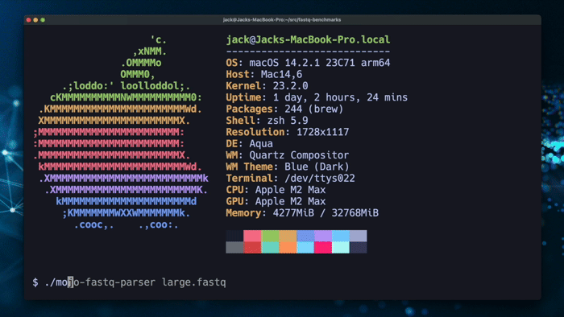
DNA Benchmark
Neofetch and Hyperfine
MojoFastTrim 🔥 was 100x faster than Python's SeqIO on Apple Silicon.
MojoFastTrim 🔥 was 50% faster than the Rust implementation on Apple Silicon.
MojoFastTrim 🔥 was on average 2x faster than the highly-optimized Python/Cython Cutadapt.

Slide 12
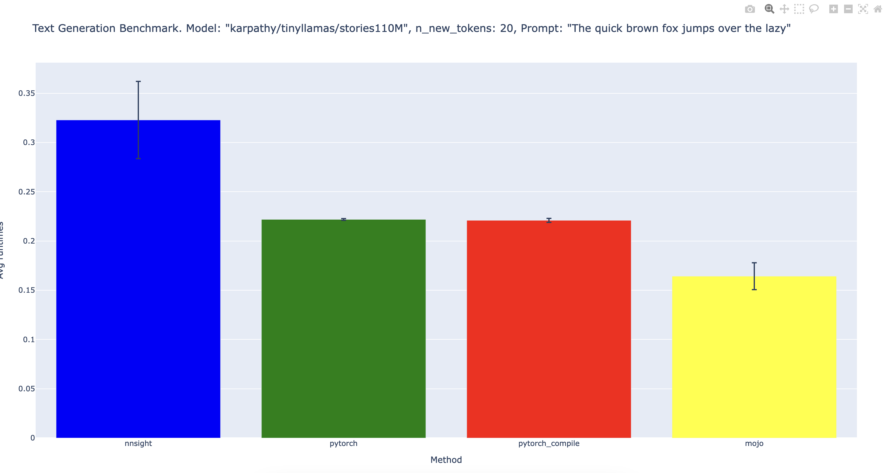
Large Language Model Benchmark
Seek feedback
Reflect on performance
Explore new techniques
Set personal goals
Iterate and adapt

Slide 13

...and on GPU?
Modular announced a partnership with NVIDIA to bring NVIDIA GPUs (A100s, H100s, etc.) to the MAX platform... eventually.

Slide 14
Performance TLDR
Mojo Feature | Real or Hype?
Performance | 🏎️
Mojo is definitely faster on CPU.
Notes:
Section: TL;DR - Mojo is definitely faster.
How to do a good benchmark. wordcloud? designer graphic?
Our results.
Llama2.mojo results. hyperfine.
playground matmul 68,000x faster demo.
fastseq demo and rust. LLVM IR versus MLIR 'next gen' compiler.
For the Julia performance python-like people, consider looking into MLIR?
Performance on GPU?

Slide 15

Usability

Slide 16
Usability
If Mojo is [legitimate], I think Mojo will win, just hands down. And the reason Mojo will win, is you don't change the paradigm of any acclimated or proficient individual. You just have to learn a bit more, and you get amazing performance. If Mojo compiles fast, and it looks like a language you're already familiar with, and it's really close to being the same speed, I just don't see how you're going to make that sell [for Rust]. The Primeagen | Online Rust Streamer

Slide 17

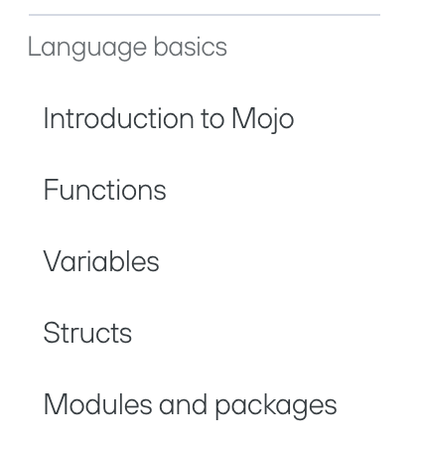
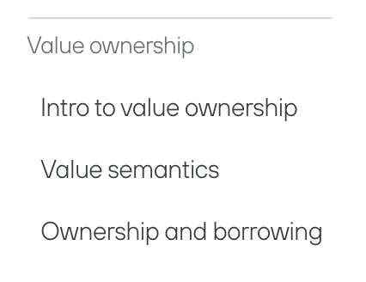
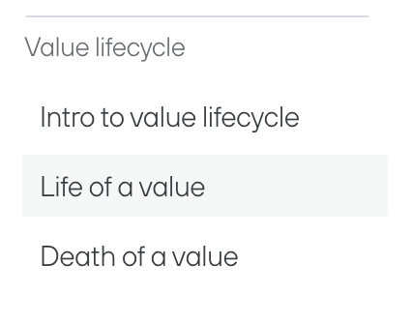
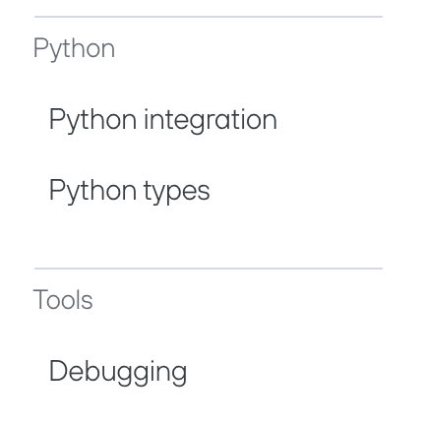
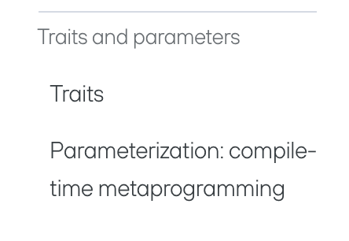
Language Reference
From https://docs.modular.com/mojo/manual/get-started/
Image: Jack Clayton – Modular AI Developer Advocate's https://mojodojo.dev/
Notes:
This section demonstrates some of the syntax differences between Python and Mojo.
For the Rustaceans in the audience, if you can be thinking about how this systems-programming language is similar to and differs from Rust.

Slide 18
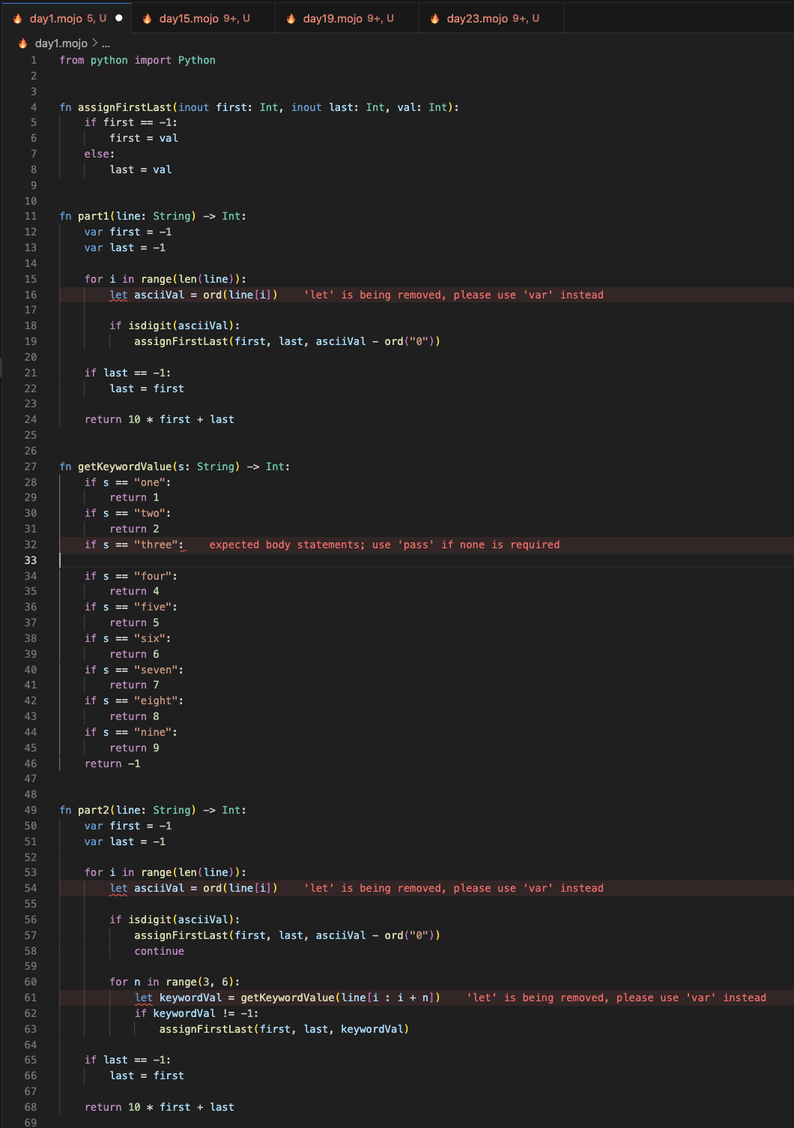
Glimpses of Mojo
Exercise built from Awesome Mojo - Advent of Code |https://github.com/isuckatcs/advent-of-code/
Instead of trying to teach a whole language in eight minutes
I'll use the Advent of Code to demonstrate some Mojo specifics
Aim: Get a feel for the syntax.
Notes:
Advent of Code is an Advent calendar of small programming puzzles for a variety of skill sets and skill levels that can be solved in any programming language you like. People use them as interview prep, company training, university coursework, practice problems, a speed contest, or to challenge each other.
You don't need a computer science background to participate - just a little programming knowledge and some problem solving skills will get you pretty far. Nor do you need a fancy computer; every problem has a solution that completes in at most 15 seconds on ten-year-old hardware.

Slide 19
Day 1
Day 1
Exercise built from Awesome Mojo - Advent of Code |https://github.com/isuckatcs/advent-of-code/
Notes:
Day 1:
1. Function Signature and `fn` vs `def` Keywords:
- Mojo functions can be declared with either `fn` or `def`.
- The `fn` declaration enforces type-checking and memory-safe behaviors (Rust style), while `def` allows no type declarations and dynamic behaviors (Python style).
- When using `fn`, the function name is followed by parameters and the return type (if any).
- Function parameters are declared with their types, such as `first: Int` and `last: Int`, providing static typing.
- The return type of the function is specified after `->`, like `-> Int`, indicating the type of value the function returns.
- Inout parameters, marked with the `inout` keyword, allow for efficient mutation of input variables without the need for explicit return values.
- Example: `fn assignFirstLast(inout first: Int, inout last: Int, val: Int)`
2. Variables:
- Mojo has two types of variables: mutable variables declared with `var` and immutable variables declared with `let`.
- Mutable variables can be reassigned, while immutable variables cannot be changed once assigned.
- The code uses both `var` and `let` to declare variables, such as `var first = -1` and `let asciiVal = ord(line[i])`.
- In the updated version of Mojo (changelog 2024.2), `let` declarations now produce a compile-time error instead of a warning, as a step towards removing `let` declarations. The compiler still recognizes the `let` keyword for now to produce a good error message, but it will be removed in subsequent releases.
3. Importing Python Modules:
- The code demonstrates importing Python modules into Mojo using the `Python` class and the `import_module()` method.
- This allows Mojo code to leverage existing Python libraries and functionality seamlessly.

Slide 20
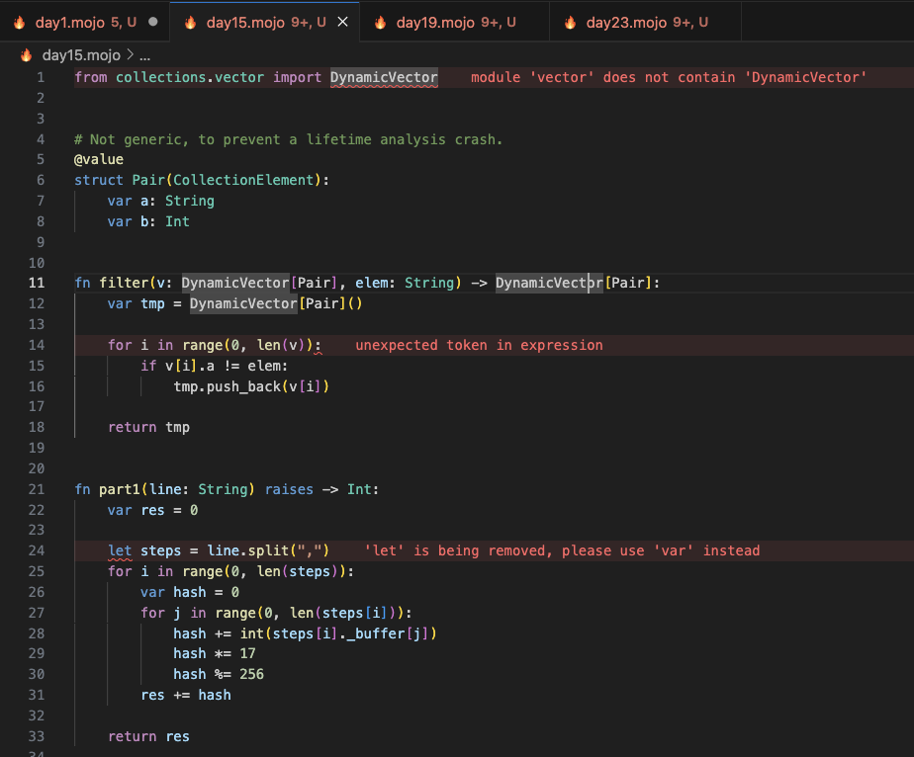
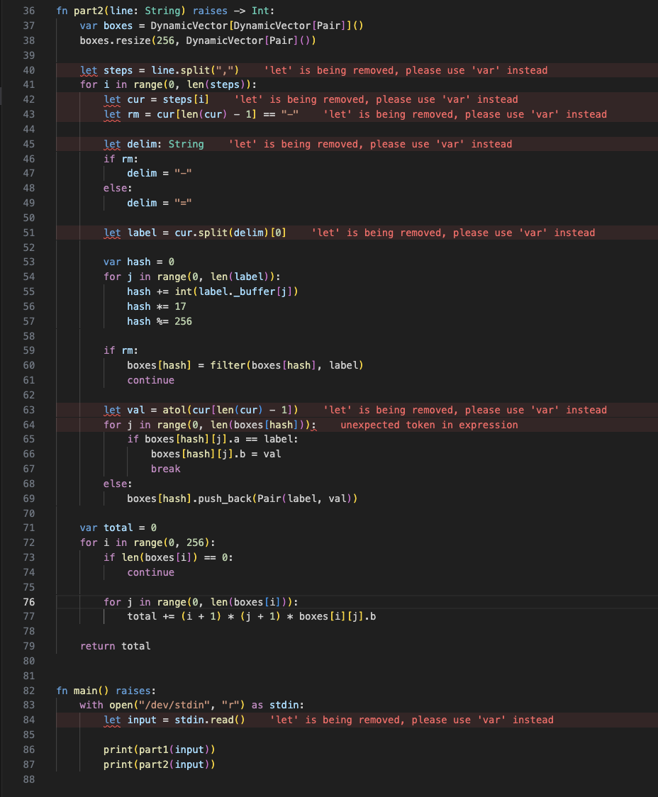
Day 1
Day 15
Notes:
Day 15:
1. Collections and Generics:
- The code utilizes the `List` type from the `collections.list` module (previously known as `DynamicVector` from `collections.vector`), which is similar to Python's `list` but with static typing.
- Generics are used to specify the type of elements in the list, such as `List[Int]` and `List[String]`, providing type safety.
2. Function Definitions with Raises:
- Mojo functions can specify the `raises` keyword to indicate that they may throw exceptions, providing explicit error handling.
- The `raises` keyword is used in function definitions like `fn part1(block: List[String]) raises -> Int`.
3. Tuple Unpacking:
- Mojo allows tuple unpacking, similar to Python's tuple unpacking.
- The code uses tuple unpacking to assign multiple variables in a single line, such as `let (rowCount, colCount) = (len(block), len(block[0]))`.

Slide 21
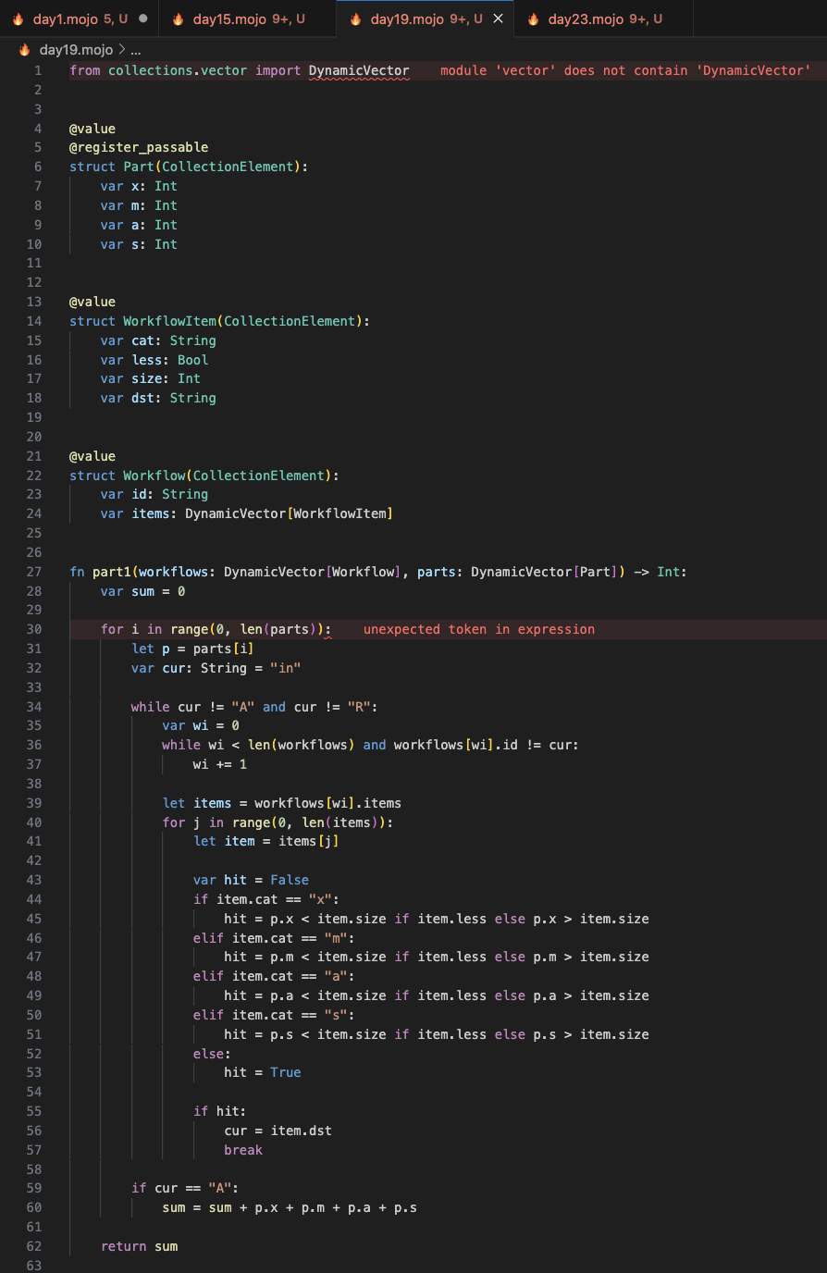
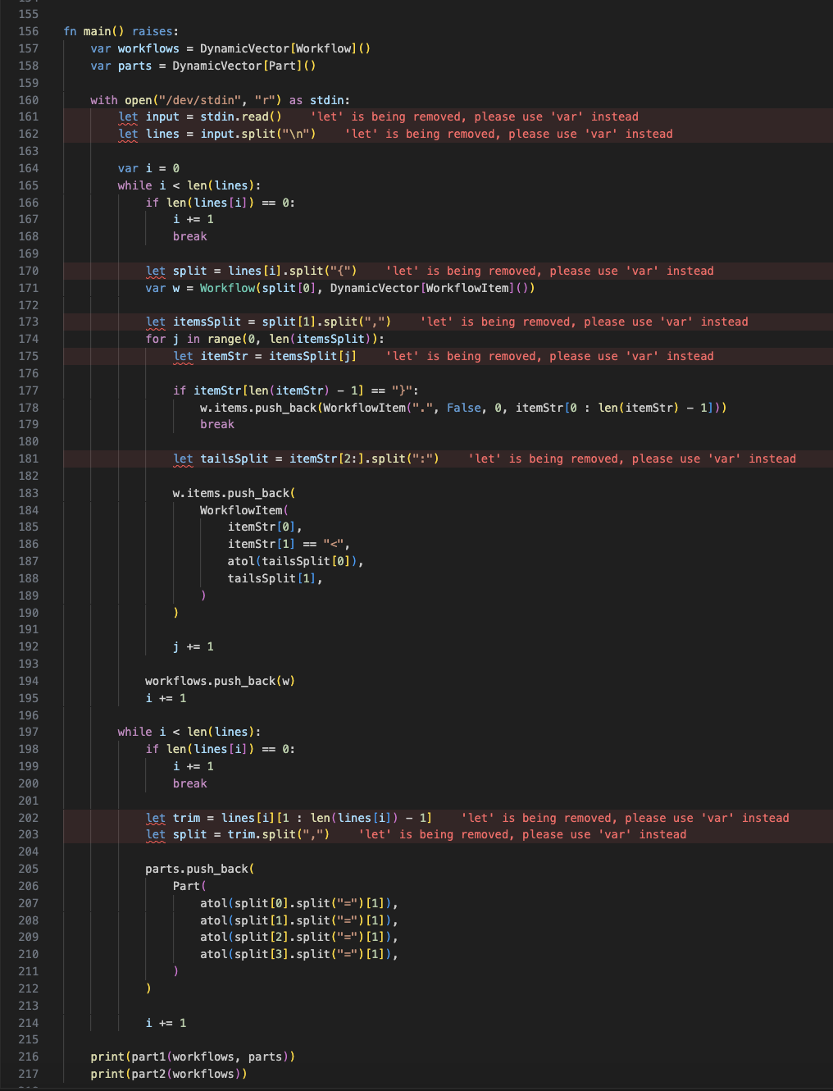
Day 1
Day 19
Notes:
Day 19:
1. Structs and Value Semantics:
- Mojo introduces the concept of structs, which are value types that can hold multiple fields.
- The `@value` decorator is used to define structs, such as `Part`, `WorkflowItem`, `Workflow`, `Range`, and `State`.
- Value types have value semantics, meaning they are copied when assigned or passed as arguments, ensuring data immutability.
2. Struct Inheritance and Traits:
- The `CollectionElement` trait is used as a base for the structs, indicating that they can be elements of a collection.
- The `@register_passable` decorator is used to register the `Part` and `Range` structs as passable, allowing them to be used as function arguments or return values.
3. Conditional Expressions:
- Mojo supports conditional expressions, similar to Python's ternary operator.
- The code uses conditional expressions like `hit = p.x < item.size if item.less else p.x > item.size` to assign values based on a condition.

Slide 22
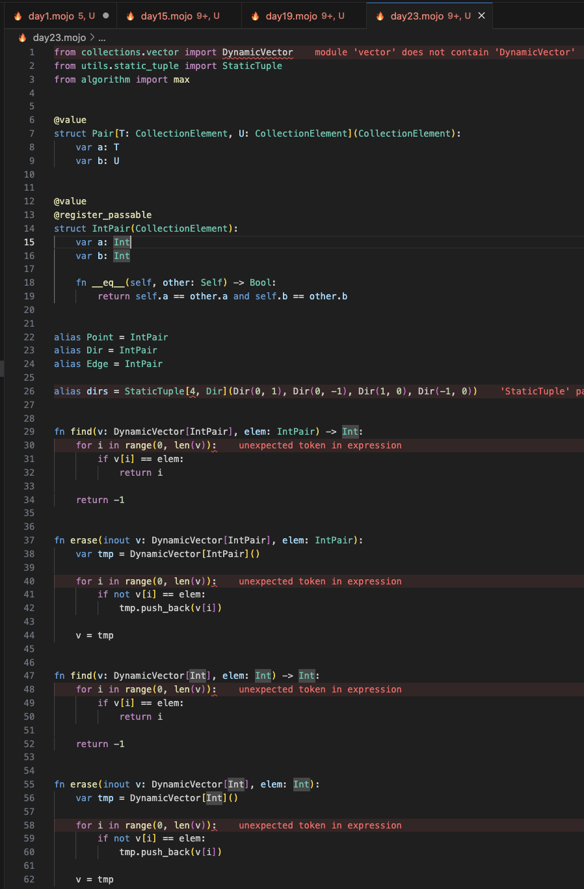
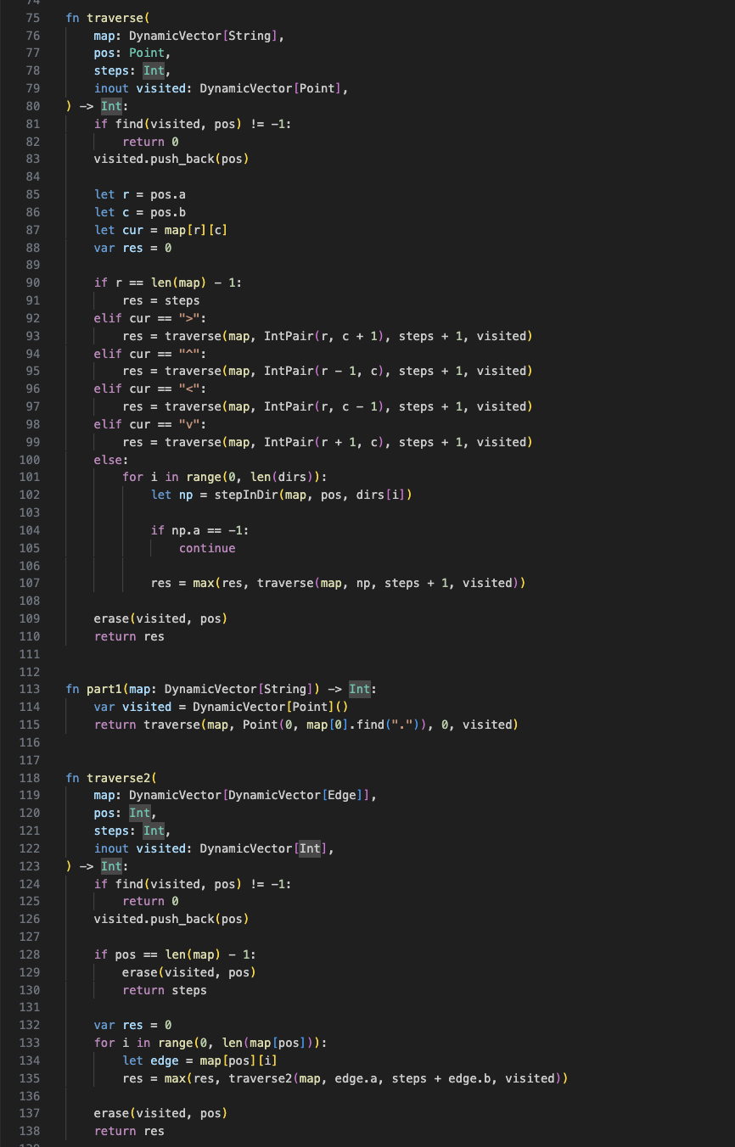
Day 1
Day 23
Notes:
Day 23:
1. Structs and Generics:
- The code defines several structs using the `@value` decorator, such as `Pair`, `IntPair`, `Point`, `Dir`, and `Edge`.
- The `Pair` struct is a generic struct that takes two type parameters, `T` and `U`, which must conform to the `CollectionElement` trait.
2. Type Aliases and Tuples:
- The code uses type aliases to create more expressive names for commonly used types, such as `Point`, `Dir`, and `Edge`, which are all aliases for `IntPair`.
- The `StaticTuple` type is used to define a tuple of fixed size and type, such as `StaticTuple[4, Dir]`.
3. Function Overloading:
- The code defines multiple functions with the same name but different parameter types, such as `find` and `erase`.
- Function overloading allows for more expressive and type-specific behavior based on the argument types.
Note: In the updated version of Mojo (changelog 2024.2), `DynamicVector` has been renamed to `List` and moved from the `collections.vector` module to the `collections.list` module. Additionally, `List.push_back()` has been removed, and the `append()` function should be used instead.
These changes reflect the evolution of the Mojo language over time, showcasing how the interface and naming conventions have been refined in recent months.

Slide 23
Usability TLDR
Mojo Feature | Real or Hype?
Performance | 🏎️
Usability | 👀
See for yourself whether you like the syntax
Notes:
Section: See for yourself how you feel about this interface for coding performant python, compared to rust/c++
despite the change to date-style versioning, 2024.2.1 is still definitely 0.X. The interface moves regularly.
Cross the River by Feeling the stones: let removal.

Slide 24

Community & Governance

Slide 25
Community & Governance
Mojo is a hybrid community. Fostering collaboration and contributions Ensuring long-term sustainability and direction
Mojo's open-source journey Open-source and proprietary sub-projects a. Open-source components (e.g., stdlib, parts of MAX engine) b. Proprietary components developed by Modular
Notes:
Mojo's open-source journey
a. Initial closed invite-only beta phase. b. The current state of their open-source journey. c. Impact of open-sourcing on community growth and engagement.

Slide 26

Community
https://github.com/modularml/mojo/discussions/2259
Notes:
Community.
Style Guide. blankcase and PascalCase versus snake_case. Sounds pretty basic to any pythonista?
Also beware there are some issues where people seem to be falsely claiming things are pythonic?
https://github.com/modularml/mojo/discussions/2259

Slide 27

Governance
Hybrid Community and Company Development.
ElasticSearch and AWS.
Cross the River by Feeling the Stones
Example: Removal of the `let` keyword.

Slide 28
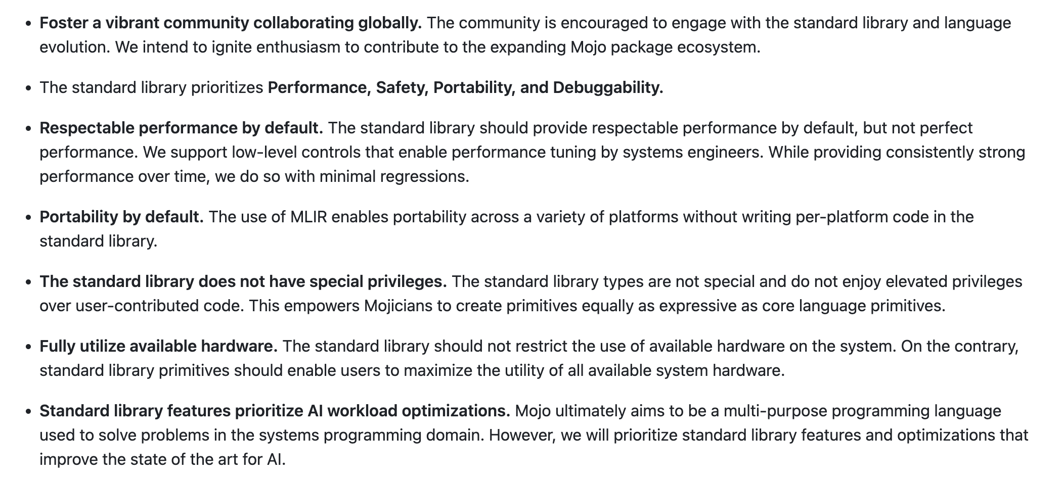
Mojo Vision differs from the Zen of Python
From https://github.com/modularml/mojo/blob/nightly/stdlib/docs/vision.md
Notes:
Mojo open-sourced the stdlib March 2024.
This language is fixing a different problem than Python solved. Inherently it will value different things.
The community and governance interaction is being figured out right now.
Note this document was last edited yesterday.

Slide 29
Will this partly open software be closed or relicensed?
He seems quite trustworthy, right?
Probably not, but...
Look at words 🏔️ Look at past actions Look at current actions.
Co-founder and CEO of Modular AI.
Built and scaled many open source compiler infrastructures, including LLVM, Clang, MLIR, and CIRCT.
Built, managed, and launched the Swift programming language.
Scaled ML systems globally bringing Google Cloud TPUs to market, unifying the ML compiler stack at Google (and beyond) with MLIR, scaling Google's SW and HW on both server and edge to impact billions of users.
Contributed to many other commercial and open source projects at Apple, Tesla and Google.
Notes:
Welcome to my favorite slide of this whole talk.
Should the Python community trust and adopt a potentially re-licensable product?
I don't think this is going to happen, but it's worth explicitly highlighting why I think this. If other more cynical Pythonistas would want to avoid adoption for this reason, I would understand.

Slide 30
Community and Governance TLDR
Mojo Feature | Real or Hype?
Performance | 🏎️
Usability | 👀
Governance | ⚖️
All looking good so far.
Notes:
Section: See for yourself whether you trust this project to remain sufficiently FOSS. If you don't trust it, go learn MLIR and add MLIR to improve Julia. There are tonnes of tutorials online If you do trust it, jump in.

Slide 31
Conclusions

Slide 32
Conclusion: Python's faster Cousin
Mojo Feature | Real or Hype?
Performance | 🏎️
Usability | 👀
Governance | ⚖️
Mojo is one-to-watch and probably not just hype.
Notes:
Overall, Mojo seems like one-to-watch, ensuring the python community is engaged with the development of mojo ensures this python superset continues.

Slide 33
Questions?

